Slide 1
Brain tumor Detection Using Convolutional neural networks
PRESENTED BY: GUIDED BY:
TARUN KUMAR- 21261A04J9 DIVYA A SAGAR
SAHITH PATIL- 21261A04K0 ASSISTANT PROFESSOR
NIDHAYA- 21261A04K3

Slide 2
AIM OF THE PROJECT
The aim of the "Brain Tumor Detection Using Machine Learning“ project is to develop a sophisticated system that leverages image processing and deep learning algorithms to accurately identify and classify brain tumors in medical images.

Slide 3
abstract
The goal of the proposed project is to use Brain image analysis and deep learning techniques to identify various diseases. This study utilizes cutting-edge technology to fill a crucial need in the healthcare industry by offering an automated, non-invasive technique for early disease detection. The project aims to develop a deep learning system to detect Brain tumor in patients by analysing images automatically. Early detection of this disease can help patients avoid vision loss or impairment. This disease's symptoms may appear due to environmental conditions or forefather inheritance or can say genetic disease. The project's implementation entails gathering data from paediatric patients, selecting suitable machine learning techniques, extracting features from pupillometry data, pre-processing for noise reduction, training the model, and fine-tuning hyperparameters. The experimental study was carried on a real-time dataset with diverse tumor sizes, locations, shapes, and different image intensities. In traditional classifier part, we applied three traditional classifiers namely Support Vector Machine (SVM), K-Nearest Neighbor (KNN) and Random Forest which was implemented in scikit-learn. Afterward, we moved on to Convolutional Neural Network (CNN) and VGG16 which are implemented using Keras and Tensorflow because they yields to a better performance than the traditional ones. In our work, CNN gained an accuracy of 85.1%, which is very compelling.
Keywords: Deep Learning, Brain Tumor, CNN, Pre-processing, Accuracy

Slide 4
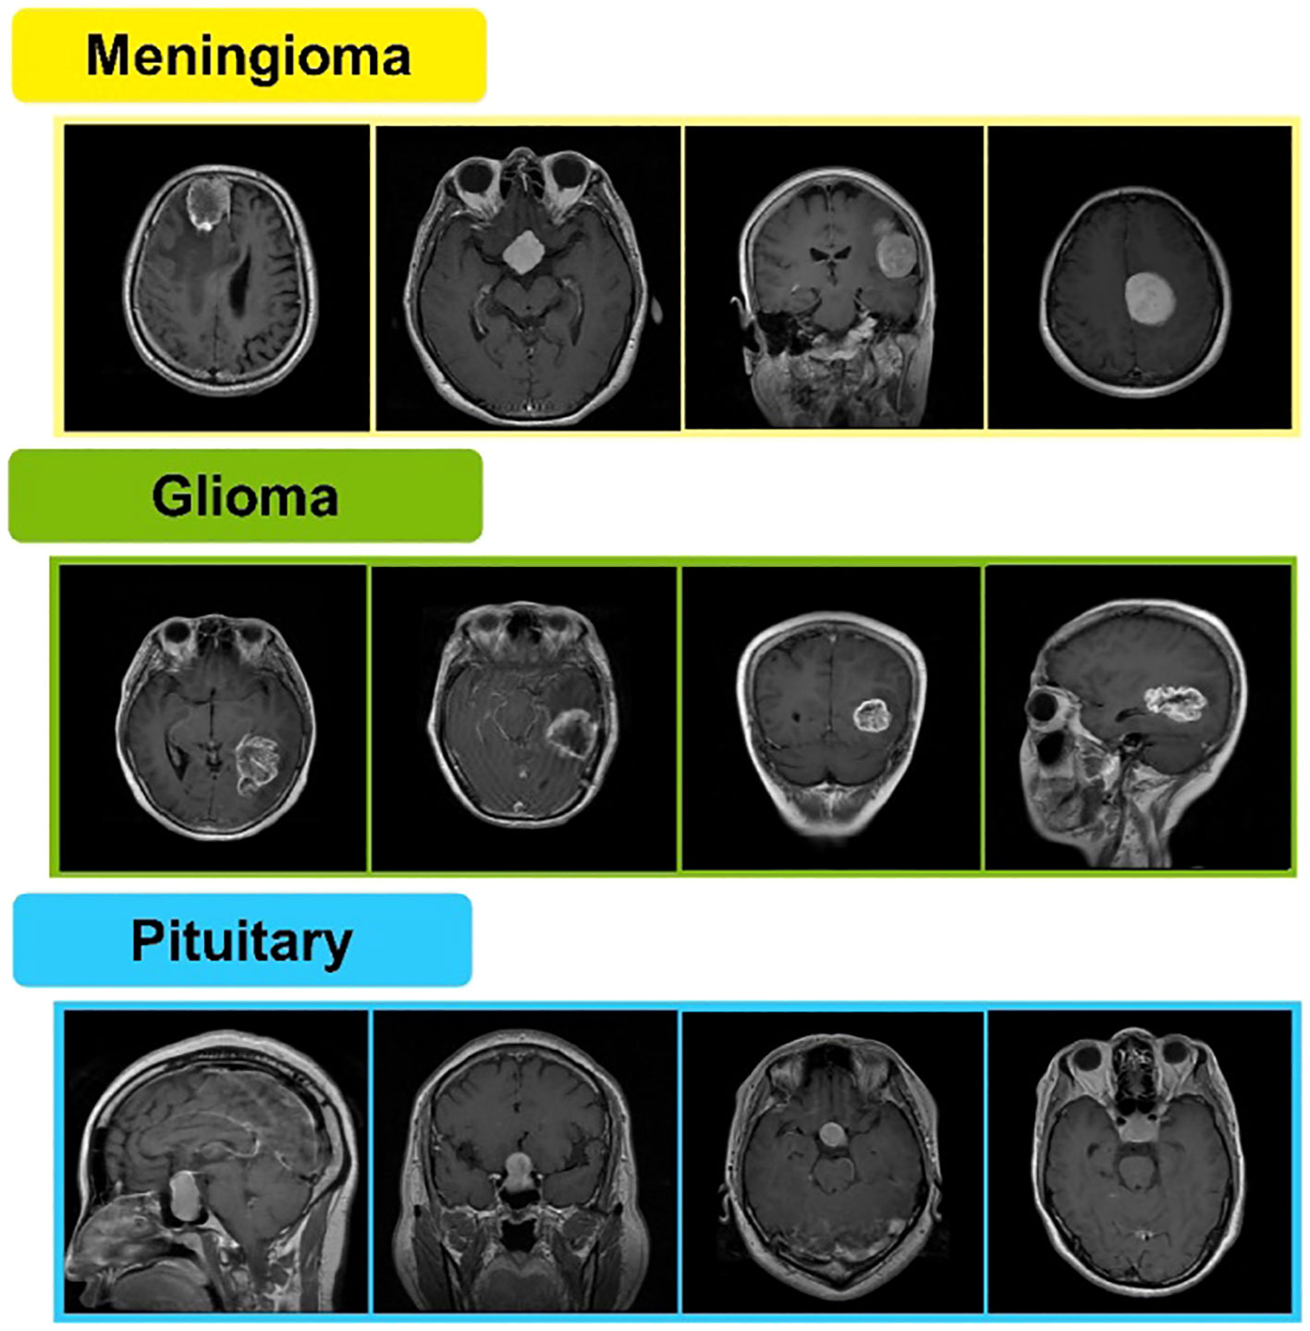
Different Types Of Tumors:

Slide 5
METHODOLOGY
Our Working Approach for Brain Tumor Segmentation We have conducted our work for brain tumor segmentation and detection in two stages.
The stages are:
Stage-1: Brain Tumor Detection using Traditional Classifiers
Stage-2: Brain Tumor Detection using Deep Learning
STAGE-1:
Step-1: Load Raw Data
Step-2: Initial Image & Label Processing
Step-3: Aggregate Data
Step-4: Image Pixel Value Processing
Step-5: Image Pixel Value Processing
Step-6: Classification by traditional classifiers

Slide 6
STAGE-2:
Using deep learning methods
Convolutional Neural networks
VGG-16

Slide 7
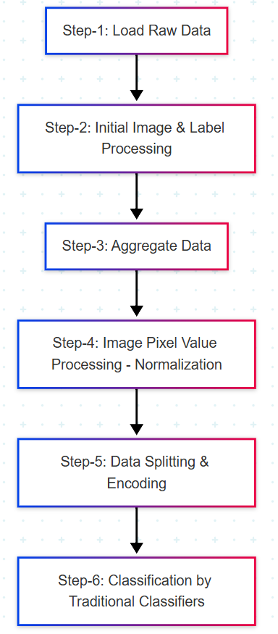
Block diagram

Slide 8
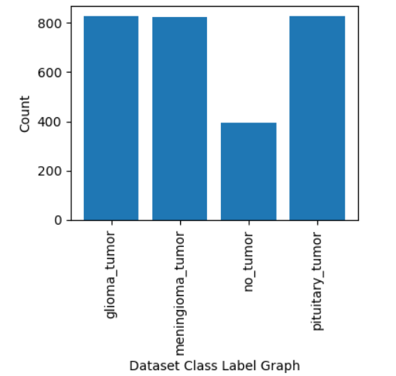
Data Set : From Kaggle
Total images found in dataset : 2870

Slide 9
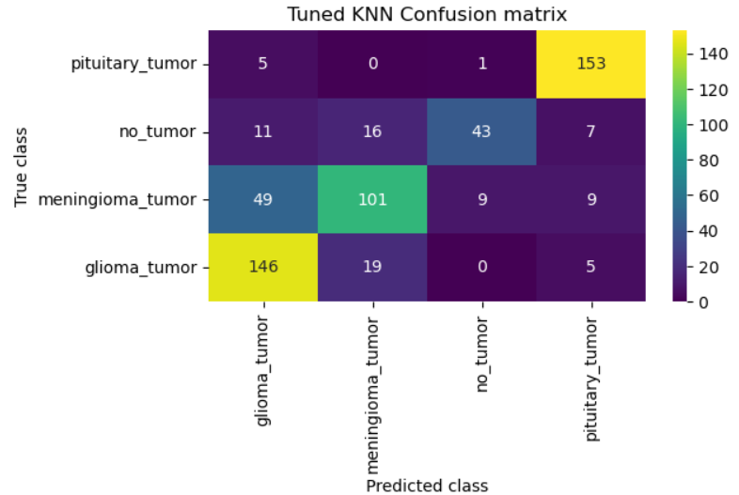
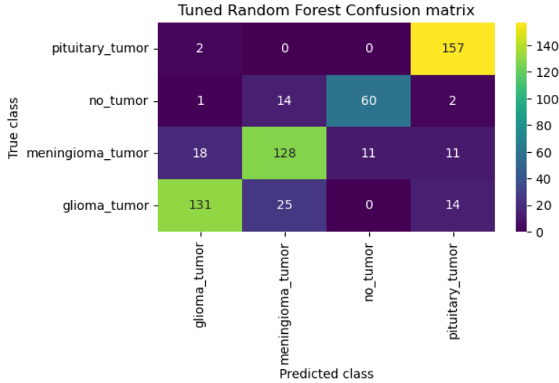
Confusion Matrix

Slide 10
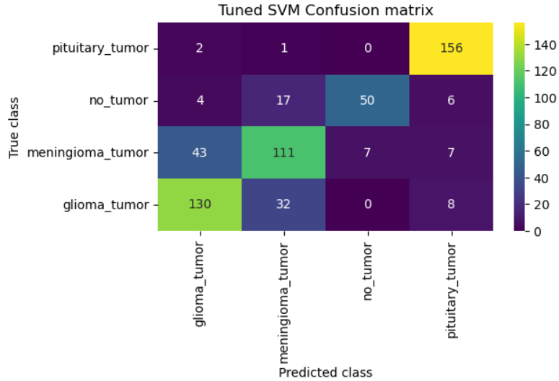
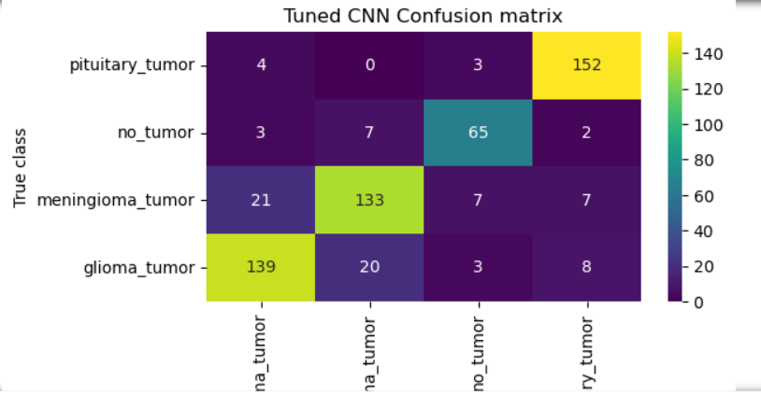

Slide 11
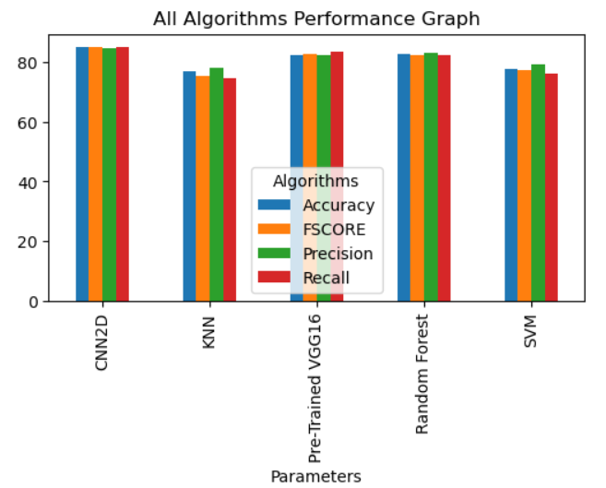
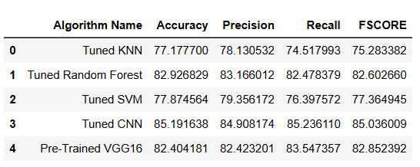
Performance Graph

Slide 12
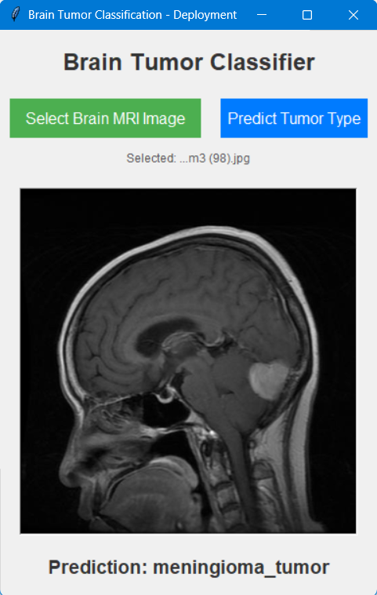
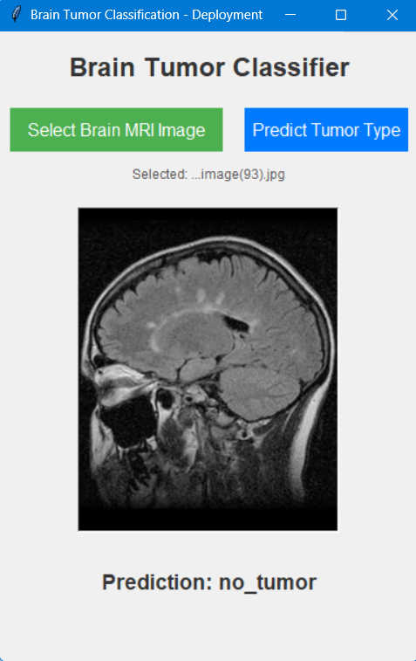
RESULTS

Slide 13
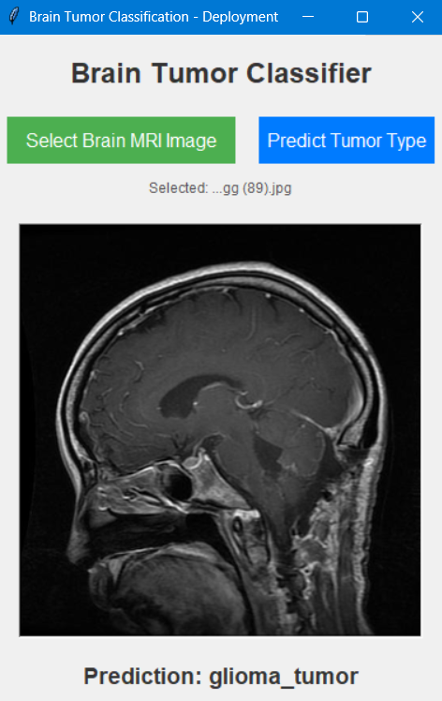
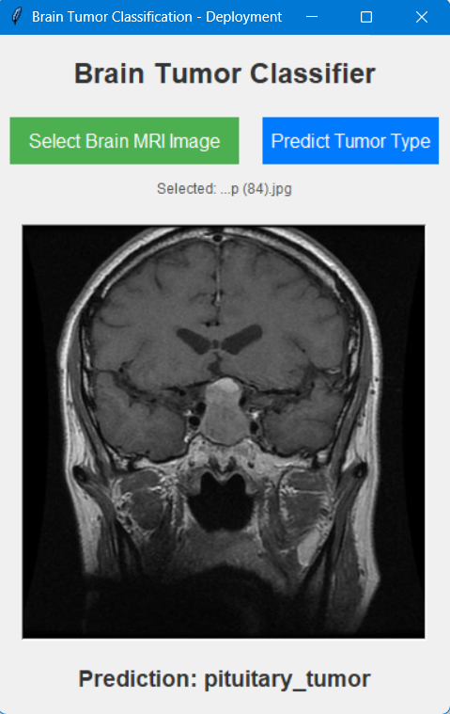

Slide 14
CONCLUSION
All Image segmentation plays a significant role in medical image processing as medical images have different diversities. For brain tumor segmentation, we used MRI and CT scan images. MRI is most vastly used for brain tumor segmentation and classification. In our work, we used traditional classifiers and Convolutional Neural Network. In the traditional classifier part, we applied and compared the results of different traditional classifiers such as K-Nearest Neighbor, Random Forest, and Support Vector Machine. Among these traditional ones, Random Forest gave us the highest accuracy of 82.9%. Further, for better results, we implemented CNN which brought in the accuracy 85.1%. In the future, we plan to work with 3D brain images, achieve more efficient brain tumor segmentation. Working with a larger dataset will be more challenging in this aspect,and we want to build a dataset emphasizing the abstract with respect to our country which will accelerate the scope of our work.

Slide 15
REFERENCES :
https://www.ijert.org/publish-dissertation-thesis online (Research Publication)
https://bmcmedimaging.biomedcen.com/article
https://youtu.be/Z44f4B6p-Kk?si=UI

Slide 16


